Slide 1
Alexa Skill
American Print house for the blind (APH) – Team ler

Slide 2
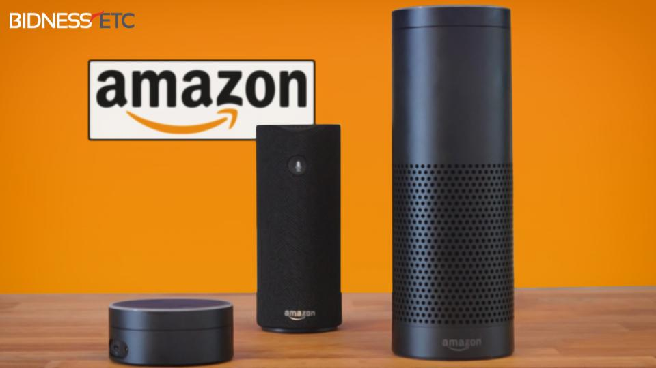
Orientation and Mobility (O&M) Alexa Skill
What is an Alexa Skill?
A application used by Amazon’s personal assistant Alexa, which can be used by the Alexa mobile app and a variety of Amazon Home Products.
A skill is built from a series of phrases that Alexa can recognize and responses that she can provide
APH has requested an O&M instructional trivia game that can be used as an educational tool through Alexa.
We will develop an Alexa Skill that will allow a user to play a trivia game with questions provided by APH

Slide 3
Technical Feasibility
APH does not have any requests as to the technical implementation, only towards the content
Able to change difficulty of questions
Multiplayer requested, but not required
Questions will be true or false and multiple choice
Some questions will include sound files that need to be played
Do not need to implement visual aspects of Alexa
Alexa Skills are implemented using JSON files provided to Amazon and then linked to a controller on Amazon’s proprietary servers, called Lamda Services.
We are considering ways to update the JSON file with new questions, in coordination with the Google Home team.

Slide 4
Social and Economic Impact
Economic:
All development costs will considered in man-hours provided by our team.
There will be no cost in continued deployment of the Skill. Amazon does not charge to post skills.
There will be no monetary economic returns involved.
However, instructors of visually impaired students will benefit in reduced prep time and increased student participation.
Social:
The Alexa system is user friendly, out-of-the-box technology, needing limited set up with the Alexa app.
Users familiar with Alexa will be able to use this new skill without any difficulty.
Any development changes after the project will be associated with the APH software team.
This skill will help to move visually impaired users toward independence.

Slide 5

Alternatives
Currently, there are no other products that help acclimate the visually impaired on the Alexa Skills platform.
APH has carried out field testing of similar ideas and surveys of instructors to determine the need for this solution.
Alternative solutions that were considered were mobile and web applications for the trivia game.
These ideas were discarded in favor of the Alexa Skill, because Alexa is an audio interface instead of visual.

Slide 6
Risks
The biggest risk is if APH suddenly loses all federal funding (60% of total budget)
This could lead to their software department being disbanded
Alexa goes obsolete
Because of the novelty of the Alexa system, the learning curve for our team might push our development timeline beyond expectations

Slide 7
Conclusion and Questions

